Slide 1
Overview of Antibiotic Classes and Individual Antibiotics
Twisha Patel, PharmD, BCPS
Clinical Specialist, Infectious Diseases
Adjunct Clinical Instructor
University of Michigan Health System
University of Michigan College of Pharmacy

Slide 2
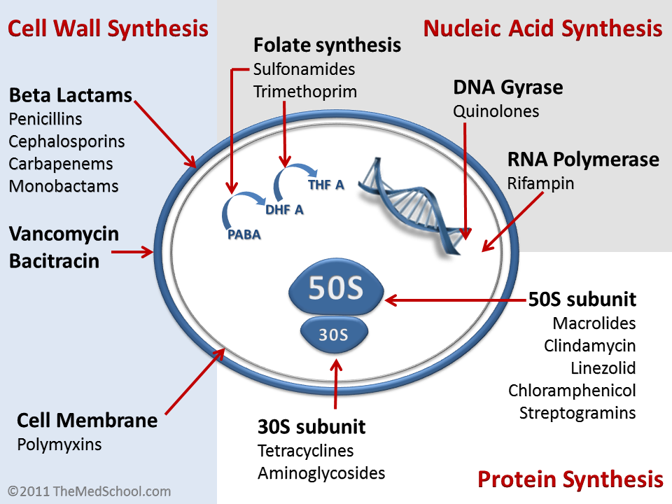
Various Mechanisms of Action

Slide 3
Gram-positive Gram-negative
Enterococcus
faecium (VRE)
Serratia
Enterococcus
faecalis
Klebsiella
pneumoniae
E. coli
S. pneumoniae
Proteus
mirabilis
Strep pyogenes
Ampicillin
Amoxicillin
H. influenzae
Staph aureus
(MSSA)
Enterobacter spp
Staph aureus
(MRSA)
Bacteroides
fragilis
Pseudomonas
Notes:
3

Slide 4
Gram-positive Gram-negative
Enterococcus
faecium (VRE)
Serratia
Enterococcus
faecalis
Klebsiella
pneumoniae
E. coli
S. pneumoniae
Proteus
mirabilis
Strep pyogenes
Nafcillin
H. influenzae
Staph aureus
(MSSA)
Enterobacter spp
Bacteroides
fragilis
Staph aureus
(MRSA)
Pseudomonas
Notes:
-Now try it for nafcillin.

Slide 5
Gram-positive Gram-negative
Enterococcus
faecium (VRE)
Serratia
Enterococcus
faecalis
Klebsiella
pneumoniae
E. coli
S. pneumoniae
Proteus
mirabilis
Strep pyogenes
Ampicillin/sulbactam
Amoxicillin/clavulanate
H. influenzae
Staph aureus
(MSSA)
Enterobacter spp
Bacteroides
fragilis
Staph aureus
(MRSA)
Pseudomonas

Slide 6
Gram-positive Gram-negative
Enterococcus
faecium (VRE)
Serratia
Enterococcus
faecalis
Klebsiella
pneumoniae
E. coli
S. pneumoniae
Proteus
mirabilis
Strep pyogenes
Piperacillin/
tazobactam
H. influenzae
Staph aureus
(MSSA)
Enterobacter spp
Bacteroides
fragilis
Staph aureus
(MRSA)
Pseudomonas
Notes:
6

Slide 7
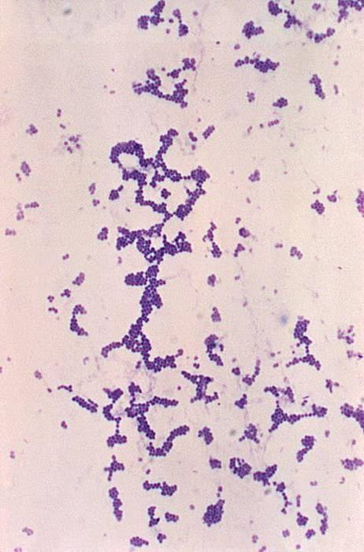
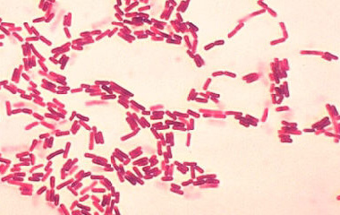
1ST Generation Cephalosporins
2nd Generation Cephalosporins
3rd Generation Cephalosporins
4th Generation Cephalosporins
GRAM POSITIVE
GRAM NEGATIVE

Slide 8
Gram-positive Gram-negative
Enterococcus
faecium (VRE)
Serratia
Enterococcus
faecalis
Klebsiella
pneumoniae
E. coli
S. pneumoniae
Proteus
mirabilis
Strep pyogenes
Cefazolin
H. influenzae
Staph aureus
(MSSA)
Enterobacter spp
Bacteroides
fragilis
Staph aureus
(MRSA)
Pseudomonas

Slide 9
Gram-positive Gram-negative
Enterococcus
faecium (VRE)
Serratia
Enterococcus
faecalis
Klebsiella
pneumoniae
E. coli
S. pneumoniae
Proteus
mirabilis
Strep pyogenes
Cefuroxime
H. influenzae
Staph aureus
(MSSA)
Enterobacter spp
Bacteroides
fragilis
Staph aureus
(MRSA)
Pseudomonas

Slide 10
Gram-positive Gram-negative
Enterococcus
faecium (VRE)
Serratia
Enterococcus
faecalis
Klebsiella
pneumoniae
E. coli
S. pneumoniae
Proteus
mirabilis
Strep pyogenes
Ceftriaxone
Cefotaxime
H. influenzae
Staph aureus
(MSSA)
Enterobacter spp
Bacteroides
fragilis
Staph aureus
(MRSA)
Pseudomonas

Slide 11
Gram-positive Gram-negative
Enterococcus
faecium (VRE)
Serratia
Enterococcus
faecalis
Klebsiella
pneumoniae
E. coli
S. pneumoniae
Proteus
mirabilis
Strep pyogenes
Ceftazidime
H. influenzae
Staph aureus
(MSSA)
Enterobacter spp
Bacteroides
fragilis
Staph aureus
(MRSA)
Pseudomonas

Slide 12
Gram-positive Gram-negative
Enterococcus
faecium (VRE)
Serratia
Enterococcus
faecalis
Klebsiella
pneumoniae
E. coli
S. pneumoniae
Proteus
mirabilis
Strep pyogenes
Cefepime
N. meningitidis
Staph aureus
(MSSA)
Enterobacter spp
Bacteroides
fragilis
Staph aureus
(MRSA)
Pseudomonas

Slide 13
Gram-positive Gram-negative
Enterococcus
faecium (VRE)
Serratia
Enterococcus
faecalis
Klebsiella
pneumoniae
E. coli
S. pneumoniae
Proteus
mirabilis
Strep pyogenes
H. influenzae
Ertapenem
Staph aureus
(MSSA)
Enterobacter spp
Bacteroides
fragilis
Staph aureus
(MRSA)
Pseudomonas

Slide 14
Gram-positive Gram-negative
Enterococcus
faecium (VRE)
Serratia
Enterococcus
faecalis
Klebsiella
pneumoniae
E. coli
S. pneumoniae
Proteus
mirabilis
Strep pyogenes
H. influenzae
Imipenem
Meropenem
Doripenem
Staph aureus
(MSSA)
Enterobacter spp
Bacteroides
fragilis
Staph aureus
(MRSA)
Pseudomonas

Slide 15
Gram-positive Gram-negative
Enterococcus
faecium (VRE)
Serratia
Enterococcus
faecalis
Klebsiella
pneumoniae
E. coli
S. pneumoniae
Proteus
mirabilis
Strep pyogenes
Aztreonam
H. influenzae
N. meningitidis
Staph aureus
(MSSA)
Enterobacter spp
Bacteroides
fragilis
Staph aureus
(MRSA)
Pseudomonas

Slide 16
Gram-positive Gram-negative
Enterococcus
faecium (VRE)
Serratia
Enterococcus
faecalis
Klebsiella
pneumoniae
E. coli
Proteus
mirabilis
S. pneumoniae
Strep pyogenes
Vancomycin
Haemophilus influenzae
Staph aureus
(MSSA)
Enterobacter spp
Bacteroides
fragilis
Staph aureus
(MRSA)
Pseudomonas

Slide 17
Gram-positive Gram-negative
Enterococcus
faecium (VRE)
Serratia
Enterococcus
faecalis
Klebsiella
pneumoniae
E. coli
S. pneumoniae
Proteus
mirabilis
Strep pyogenes
Daptomycin
Haemophilus influenzae
Staph aureus
(MSSA)
Enterobacter spp
Bacteroides
fragilis
Staph aureus
(MRSA)
Pseudomonas

Slide 18
Gram-positive Gram-negative
Enterococcus
faecium (VRE)
Serratia
Enterococcus
faecalis
Klebsiella
pneumoniae
E. coli
S. pneumoniae
Proteus
mirabilis
Strep pyogenes
Azithromycin &
Clarithromycin
Haemophilus influenzae
Staph aureus
(MSSA)
Enterobacter spp
Bacteroides
fragilis
Staph aureus
(MRSA)
Pseudomonas

Slide 19
Gram-positive Gram-negative
Enterococcus
faecium (VRE)
Serratia
Enterococcus
faecalis
Klebsiella
pneumoniae
E. coli
S. pneumoniae
Proteus
mirabilis
Strep pyogenes
Haemophilus influenzae
Clindamycin
Staph aureus
(MSSA)
Enterobacter spp
Bacteroides
fragilis
Staph aureus
(MRSA)
Pseudomonas

Slide 20
Gram-positive Gram-negative
Enterococcus
faecium (VRE)
Serratia
Enterococcus
faecalis
Klebsiella
pneumoniae
E. coli
S. pneumoniae
Proteus
mirabilis
Strep pyogenes
Linezolid
Haemophilus influenzae
Staph aureus
(MSSA)
Enterobacter spp
Bacteroides
fragilis
Staph aureus
(MRSA)
Pseudomonas

Slide 21
Gram-positive Gram-negative
Enterococcus
faecium (VRE)
Serratia
Enterococcus
faecalis
Klebsiella
pneumoniae
E. coli
S. pneumoniae
Proteus
mirabilis
Strep pyogenes
Levofloxacin
Haemophilus influenzae
Staph aureus
(MSSA)
Enterobacter spp
Bacteroides
fragilis
Staph aureus
(MRSA)
Pseudomonas

Slide 22
Gram-positive Gram-negative
Enterococcus
faecium (VRE)
Serratia
Enterococcus
faecalis
Klebsiella
pneumoniae
E. coli
S. pneumoniae
Proteus
mirabilis
Strep pyogenes
Ciprofloxacin
Haemophilus influenzae
Staph aureus
(MSSA)
Enterobacter spp
Bacteroides
fragilis
Staph aureus
(MRSA)
Pseudomonas

Slide 23
Gram-positive Gram-negative
Enterococcus
faecium (VRE)
Serratia
Enterococcus
faecalis
Klebsiella
pneumoniae
E. coli
S. pneumoniae
Proteus
mirabilis
Strep pyogenes
Moxifloxacin
Haemophilus influenzae
Staph aureus
(MSSA)
Enterobacter spp
Bacteroides
fragilis
Staph aureus
(MRSA)
Pseudomonas

Slide 24
Gram-positive Gram-negative
Enterococcus
faecium (VRE)
Serratia
Enterococcus
faecalis
Klebsiella
pneumoniae
E. coli
S. pneumoniae
Proteus
mirabilis
Strep pyogenes
TMP/SMX
Haemophilus influenzae
Staph aureus
(MSSA)
Enterobacter spp
Bacteroides
fragilis
Staph aureus
(MRSA)
Pseudomonas

Slide 25
Gram-positive Gram-negative
Enterococcus
faecium (VRE)
Serratia
Enterococcus
faecalis
Klebsiella
pneumoniae
E. coli
Proteus
mirabilis
S. pneumoniae
Strep pyogenes
Metronidazole
Haemophilus influenzae
Staph aureus
(MSSA)
Enterobacter spp
Bacteroides
fragilis
Staph aureus
(MRSA)
Pseudomonas

Slide 26
Gram-positive Gram-negative
Enterococcus
faecium (VRE)
Serratia
Enterococcus
faecalis
Klebsiella
pneumoniae
E. coli
Proteus
mirabilis
S. pneumoniae
Strep pyogenes
Haemophilus influenzae
Fosfomycin
Staph aureus
(MSSA)
Enterobacter spp
Bacteroides
fragilis
Staph aureus
(MRSA)
Pseudomonas

Slide 27
Gram-positive Gram-negative
Enterococcus
faecium (VRE)
Serratia
Enterococcus
faecalis
Klebsiella
pneumoniae
E. coli
S. pneumoniae
Proteus
mirabilis
Strep pyogenes
Gentamicin
Haemophilus influenzae
Staph aureus
(MSSA)
Enterobacter spp
Bacteroides
fragilis
Staph aureus
(MRSA)
Pseudomonas

